Slide 1
Cultural Intelligence, in today’s organizations and workplaces
June 16, 2020
Group 4
Sweeny, Nardray (301102880)
Jomaa, Yusef (30096191)
Liang, Elyse (301077651)
Luo, Zhenyu (301035588)
Wu, Jianheng（300772729）

Slide 2
Agenda
1. Is Cultural Intelligence important (CQ)?
2. The importance of cultural intelligence in organizations?
3. Can managers cultivate cultural intelligence?
Conclusion

Slide 3
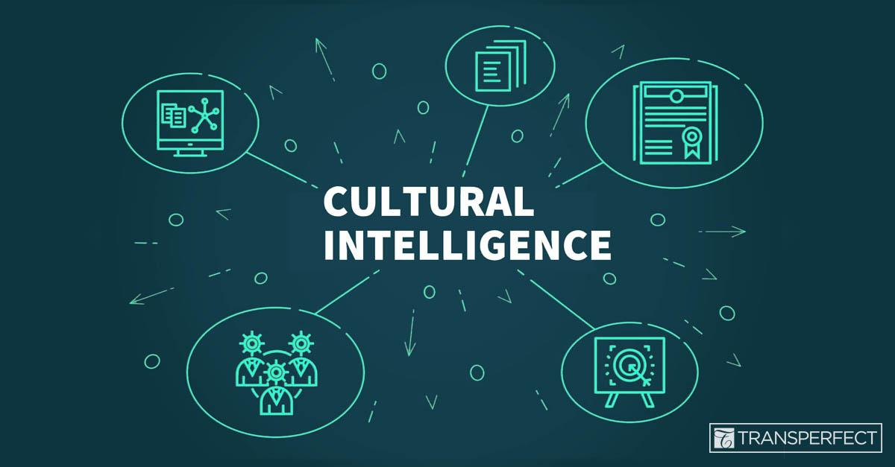
Introduction
What is cultural intelligence?
  The skill to work effectively in culturally diverse situations
Image: https://www.transperfect.com/blog/are-you-culturally-intelligent-why-a-high-cq-is-key-to-global-business-success

Slide 4
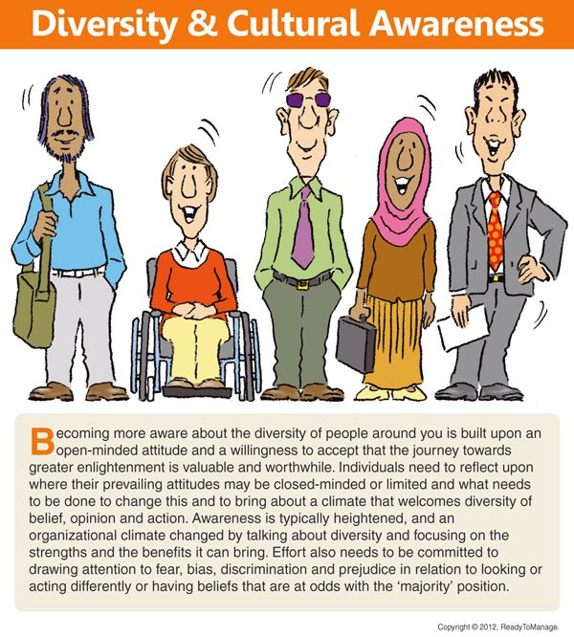
Is Cultural Intelligence important (CQ)
We are all not the same!
Interesting facts
FOOD
CLOTHING
LANGUAGE
APPEARANCE
(Warner, 2012)

Slide 5
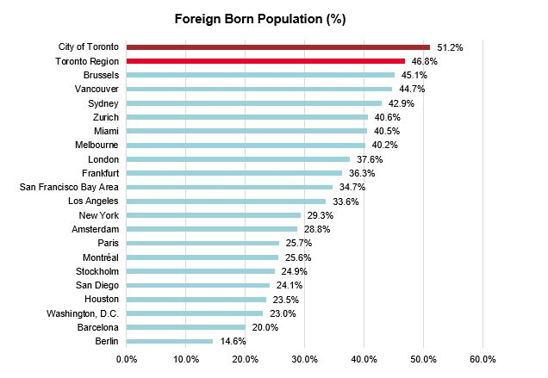
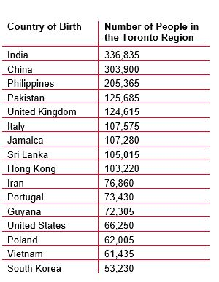
Is cultural intelligence important (CQ)
Developing Cognitive Flexibility
Motivational CQ
Behavioural CQ
Statistics Canada, Census 2016
Statistics Canada Census 2016

Slide 6
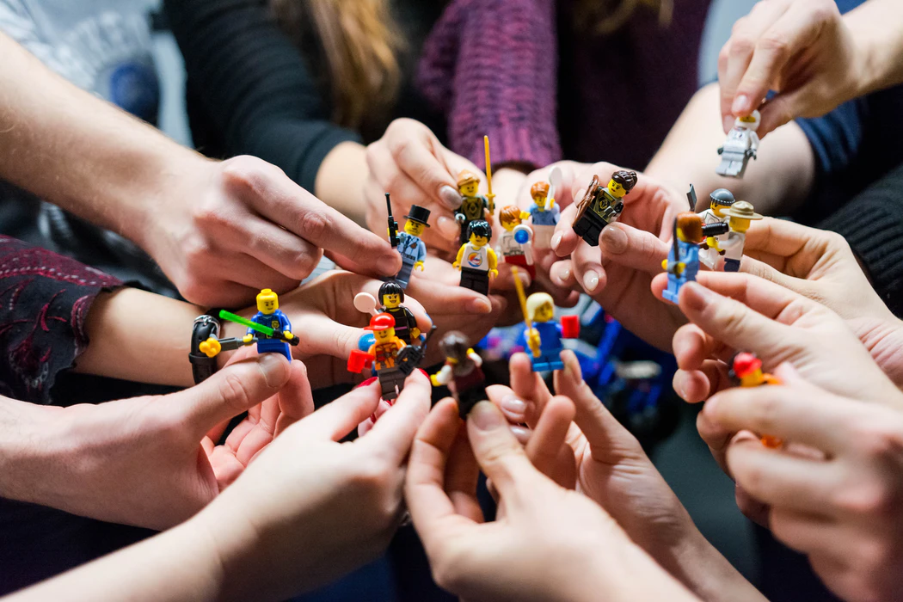
The importance of cultural intelligence in organizations
1. Build strong team
  Facilitate more objective and more creative team outcome (Courtland L. Bovée, 2018).
  Reduce the possibility of facing hard time on diversified teamwork (P. Christopher Earley, 2004).
Image:(Hilitanu, n.d.)

Slide 7

The importance of cultural intelligence in organizations
2. Create cultural awareness among co-workers
  Focus on each other's needs for more positive interactions by increasing our understanding of each other (Courtland L. Bovée, 2018).
  Be able to protect the company's reputation by overcoming communication barriers and disagreements that may arise due to cultural diversity (Courtland L. Bovée, 2018).
Image: (You X Ventures, n.d.)

Slide 8

The importance of cultural intelligence in organizations
3. Add a diverse structure to the hiring process
  Benefit from the diversity of employees, improve the company's understanding of different markets through the diversity of employees' different perspectives of thinking (Courtland L. Bovée, 2018).
  Be more tolerant for good candidates from different cultures when making hiring decisions (TRIANDIS, 2006).
Image: (Christina @ wocintechchat.com, n.d.)

Slide 9

How can people cultivate cultural intelligence ?
-Memorization (mental)
Completely master the beliefs, customs and taboos of foreign cultures by rote memorization, it is not very effective. (by P. Christopher Earley and Elaine Mosakowski, 2004 )
Image: https://zhuanlan.zhihu.com/p/78644756

Slide 10

How can people cultivate cultural intelligence ?
-Join in a new culture to live (Physical)
Being able to get along well with foreign friends and colleagues shows that you understand their culture. At the same time, your mannerism shows to a certain extent that you have integrated into their world.(by P. Christopher Earley and Elaine Mosakowski, 2004 )
image:https://www.educations.cn/study-guides/europe/study-in-belgium/

Slide 11

How can people cultivate cultural intelligence ?
-Faith a new culture from the deep (emotional)
Adapting to a new culture means overcoming many obstacles and setbacks, and you can only do this if you believe in them from the heart.(by P. Christopher Earley and Elaine Mosakowski, 2004 )
Image: https://nzmao.com/?p=32642

Slide 12
Conclusion
→Three Important of culture intelligence
→The role of culture intelligence in organization
→Training culture intelligence

Slide 13
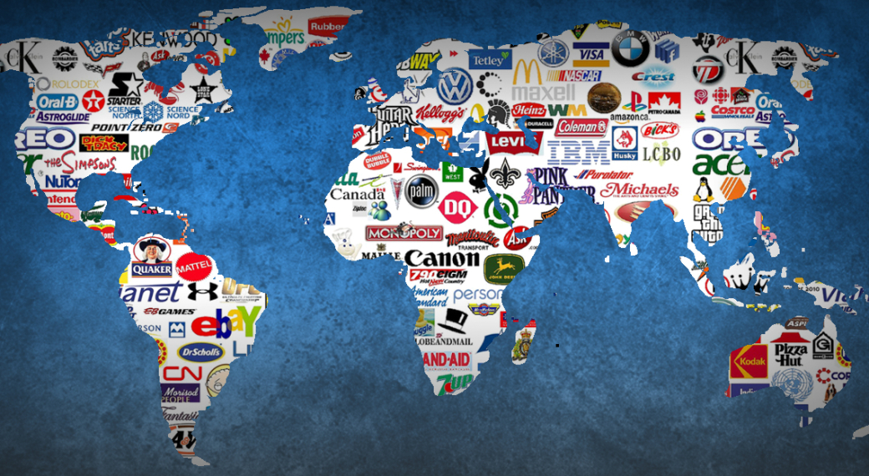
Conclusion
Economic globalization
→Successful company should
develop the cultural intelligence
and adapt to all over the world
https://itishreechy01.wordpress.com/2016/09/30/economic-globalization-of-israel/
inmage：

Slide 14
Sources
Christina @ wocintechchat.com. (n.d.). N/A. Retrieved 06 14, 2020, from unsplash.com: https://unsplash.com/photos/0Nfqp0WiJqc
Courtland L. Bovée, J. V. (2018). CHAPTER 1. In J. V. Courtland L. Bovée, Business Communication Essentials (pp. 4-17). New York: Pearson Education.
Hilitanu, V. (n.d.). Team Lego, Iasi, Romania. Retrieved 06 14, 2020, from unsplash.com: https://unsplash.com/photos/1FI2QAYPa-Y
P. Christopher Earley, E. M. (2004, 10). Cultural Intelligence. Retrieved from Harvard Business Review: https://hbr.org/2004/10/cultural-intelligence
TRIANDIS, H. C. (2006). Cultural Intelligence in Organizations. Group & Organization Management, 31(1), 20-26. doi:10.1177/1059601105275253
You X Ventures. (n.d.). N/A. Retrieved 06 14, 2020, from unsplash.com: https://unsplash.com/photos/Oalh2MojUuk
Allan B.I Bernardo, A. P. (2018). Cognitive flexibility and cultural intelligence: Exploring the cognitive aspects of effective functioning in culturally diverse contexts. Elsevier .
Global, T. (2019, 03 22). HOW MULTICULTURAL IS TORONTO? LET US COUNT THE WAYS.. Retrieved from torontoglobal.ca: https://torontoglobal.ca/TG-Blog/March-2019/How-multicultural-is-Toronto-Let-us-count-the-way
Warner, D. J. (2012). Diversity and Cultural Awareness. Diversity Cartoon. Business Cartoons for Presentation, Los Angeles , California , America. Retrieved from http://blog.readytomanage.com/diversity-cartoon/

Slide 15
Sources
Source: Statistics Canada, Census 2016; U.S. Census Bureau, American Community Survey, 2016; Eurostat; UK Office for National Statistics; Australian Bureau of Statistics
Cultural Intelligence, by P. Christopher Earley and Elaine Mosakowski, From the October 2004 Issue. https://hbr.org/2004/10/cultural-intelligence
Are You Culturally Intelligent? Why a High CQ is Key to Global Business Success. (n.d.). Retrieved from https://www.transperfect.com/blog/are-you-culturally-intelligent-why-a-high-cq-is-key-to-global-business-success

